Slide 1
PHIL 201
Chapter 6
Categorical Syllogisms

Slide 2
Categorical Syllogisms
A syllogism is a deductive argument consisting of two premises and one conclusion.
A categorical syllogism is a syllogism that is composed entirely of categorical propositions that is capable of being translated into standard form.
Here’s an example:
All soldiers are patriots.
No traitors are patriots.
Therefore, no traitors are soldiers.
An important feature of categorical syllogisms is that the categorical propositions refer to three different categories.
The logical structure of the syllogism relates these three categories to each other.

Slide 3
Naming Terms and Premises
Depending on the role played by each of the terms in the syllogism, we can supply the terms with identifying names.
The major term is the predicate of the conclusion.
The minor term is the subject of the conclusion.
The middle term, which provides the middle ground between the two premises, is the one that occurs once in each premise and does not occur in the conclusion.
Thus, for the syllogism on the last slide, the major term is "soldiers," the minor term is "traitors," and the middle term is "patriots.”
These names also allow us to identify by name the two premises in the syllogism. The premise that contains the major term is the major premise. The premise that contains the minor term is the minor premise.

Slide 4
Standard-Form Categorical Syllogisms
Evaluating categorical syllogisms is dependent upon another concept: standard form.
A standard form categorical syllogism is one that meets three requirements:
All three statements must be standard-form categorical propositions.
The two occurrences of each term must be identical and have the same sense.
The major premise must occur first, the minor premise second, and the conclusion last.
Major Premise: All comedians are shy people.
Minor Premise: Some comedians are good actors.
Some good actors are shy people.

Slide 5
Syllogistic Mood and Figure
Putting a categorical syllogism in standard form allows us to analyze the form of the argument for validity.
There are two elements of this analysis: mood and figure.
The mood of a categorical syllogism consists of the letter names of the propositions that make it up.
For example, if the major premise is an A proposition, the minor premise an O proposition, and the conclusion an E proposition, the mood is AOE.
All P are M. No P are M.
All S are M Mood: AAA No S are M. Mood: EEO
All S are P. Some S are not P.

Slide 6
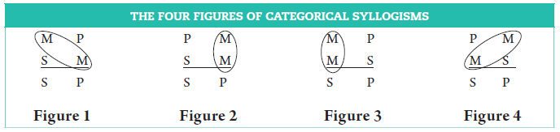
Syllogistic Figure
The figure of a categorical syllogism is determined by the location of the two occurrences of the middle term in the premises of a standard form syllogism.
Four different arrangements are possible.

Slide 7
A Simple (but brain busting) Test
Specifying the mood and figure of a categorical syllogism provides us all that we need to determine if the syllogism is valid.
Consider this example:
No painters are sculptors.
Some sculptors are artists.
Therefore, some artists are not painters.
The mood of the syllogism is EIO. Consideration of the location of the middle term (sculptors) reveals that this is a figure 4 syllogism. So, the complete formal determination of the syllogism is EIO-4.
Given that there are 64 possible syllogistic moods, and 4 different figures, there are only 256 possible syllogistic forms.

Slide 8
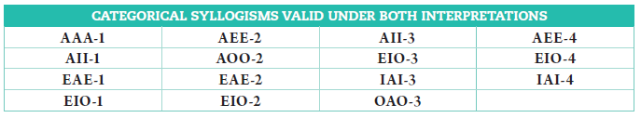
Syllogisms and Validity
Long ago, logicians analyzed all of the 256 possibilities, and identified which of the forms are unconditionally valid (valid from both the Boolean and Aristotelian contexts).
An additional 9 are conditionally valid (that is, valid from the Aristotelian context, assuming that the subject terms of universal propositions refer to actually existing things).
An individual could just memorize the lists of these forms, but we don’t have to. Instead we will develop some machinery that allows us to do the evaluative work.

Slide 9
Exercise 6B
Example
No swimmers are lazy people.
Some lazy people are members of fitness clubs.
Some members of fitness clubs are not swimmers.
Answer
A. Major term: swimmers
B. Minor term: members of fitness clubs
C. Middle term: lazy people
D. Mood: EIO
E. Figure: 4

Slide 10
Venn Diagrams for Categorical Syllogisms
We can use our old friend the Venn diagram to quickly and easily test any categorical syllogism for validity.
When we were using Venn diagrams to graph categorical propositions, we used two interlocking circles to represent the classes named by the terms.
In categorical syllogisms, there are three terms being related to each other, and so we need a slightly more complicated diagram to graph the relations.
As the diagram on the next slide shows, constructing a Venn diagram for a syllogism requires us to carefully interlock the circles representing the terms. In all, there are 8 areas in logical space created by such a diagram (including everything that is not a member of the classes named by the terms).
Note that by convention, the diagram is constructed with the minor term (the subject term of the conclusion) on the left, the major term (the predicate term of the conclusion) on the right, and the middle term straddling the two to the top.

Slide 11
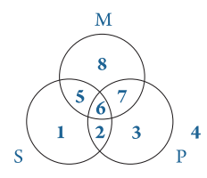
The Diagram

Slide 12
The Test
Testing a categorical syllogism using a Venn diagram requires us to translate the premises into the diagram and then reading the diagram to determine if the conclusion is specified there.
If it is, the truth of the premises does guarantee the truth of the conclusion and the argument is valid.
If it isn’t, then the truth of the premises does not guarantee the truth of the conclusion and the argument is invalid.
Doing this takes a little bit of practice, and thus the best way to learn the technique is just to do problems.
However, there are a few general rules for creating the diagrams that are helpful to review.

Slide 13
Tips for constructing Venn diagrams for Categorical Syllogisms
Marks (shading or placing an X) are entered only for the premises. No marks are made for the conclusion.
If the argument contains one universal premise, this premise should be entered first in the diagram. If there are two universal premises, either one can be done first.
When entering the information contained in a premise, one should concentrate on the circles corresponding to the two terms in the statement. While the third circle cannot be ignored altogether, it should be given only minimal attention.
When inspecting a completed diagram to see whether it supports a particular conclusion, one should remember that particular statements assert two things. "Some S are P" means "At least one S exists and that S is a P"; "Some S are not P" means "At least one S exists and that S is not a P."
When shading an area, one must be careful to shade all of the area in question.
The area where an X goes is always initially divided into two parts. If one of these parts has already been shaded, the X goes in the unshaded part.
An X should never be placed in such a way that it dangles outside of the diagram, and it should never be placed on the intersection of two lines.
Be sure to review the discussion of constructing venn diagrams in the text, paying special attention to the diagrammatic examples provided there.

Slide 14
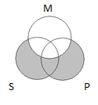
Exercise 6C
Example
All P are M.
All S are M.
All S are P.
Answer
INVALID
Conclusion “All S are P” requires
that both Areas 1 and 5 be shaded.

Slide 15
Rules and Fallacies
There is another technique that can be employed to test the validity of categorical syllogisms.
It comes in the form of a set of rules which must be obeyed by a syllogism for it to be valid. Breaking the rules produces a formal fallacy and thus the argument is invalid.
Like the valid standard forms, this technique requires memorization of the rules, and thus is best as a technique for checking analysis done via Venn diagram.
The text uses a set of 5 rules specified on the following slide.
Two of the rules use the concept of distribution (from our discussion of categorical propositions); two employ the concept of quality; the last employs the concept of quantity.

Slide 16
Rules and Fallacies Under the Modern Interpretation
Rule 1: The middle term must be distributed in at least one premise.
Associated Fallacy: Undistributed middle
Rule 2: If a term is distributed in the conclusion, then it must be distributed in a premise.
Associated Fallacies: Illicit major/illicit minor
Rule 3: A categorical syllogism cannot have two negative premises.
Associated Fallacy: Exclusive premises
Rule 4: A negative premise must have a negative conclusion.
Associated fallacy: Affirmative conclusion/negative premise
Rule 5: A negative conclusion must have a negative premise.
Associated Fallacy: Negative conclusion/affirmative premises
Rule 6: Two universal premises cannot have a particular conclusion.
Associated Fallacy: Existential fallacy

Slide 17
Exercises 6D
Example I (we will not be doing II and III of 6d)
IAI-3
Answer
VALID: All six rules are met.
Rule 1: The middle term is distributed in the second premise.
Rule 2: The major term is not distributed in the conclusion.
Rule 3: It does not have two negative premises.
Rule 4: It does not have a negative premise.
Rule 5: It does not have a negative conclusion.
Rule 6: It does not have universal premises and a particular conclusion.

Slide 18
Boolean vs. Aristotelian
Because of the ‘closed’ character of the Boolean standpoint, testing syllogisms using Venn diagrams is easier from this standpoint then from the Aristotelian.
Any syllogism found valid from the Boolean perspective is unconditionally valid.
The Aristotelian ‘openness’ adds a wrinkle that makes things slightly more complicated.
When graphing universal premises in the Aristotelian context, it’s openness requires that we provisionally assume that the entities named in the premise actually exist.
We show this assumption using a circled x in the appropriate area of the diagram
After analyzing the diagram, any arguments that require reference to the assumption are conditionally valid.
We can remove that ‘conditionally’ if and only if the entities in question do in fact exist.
Please review the examples of both perspectives in the text.

Slide 19
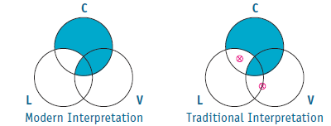
Diagramming in the Traditional Interpretation
Both interpretations can give the same results:
Both valid
Both invalid
No V are C.
All C are L.
Some L are V.
INVALID: In this example, it is possible for the conclusion Some L are V to be false under both interpretations.

Slide 20
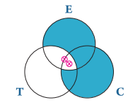
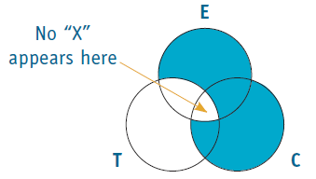
Diagramming in the Traditional Interpretation
Validity of syllogism depends on assumption of existence when both:
Conclusion is a particular proposition (I, O); and
Both of the premises are universal statements (A, E)
All C are E. Traditional Interpretation Modern Interpretation
All E are T.
Some T are C.

Slide 21
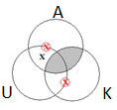
Exercises 6E
Example
No K are A.
Some U are A.
Some U are not K.
Answer
VALID

Slide 22
Rules and Fallacies under the Traditional Interpretation
Rule 6 (Modern Interpretation): Two universal premises cannot have a particular conclusion
Rule 6 (Traditional Interpretation): Since universal propositions assert existential import, a syllogism with two universal premises and a particular conclusion CAN be provisionally valid (if objects exist).

Slide 23
Exercise 6F
Example (modified from text)
All cynics are egoists.
All egoists are talented people.
Some talented people are cynics.
Answer
All C are E.
All E are T.
Some T are C.
PROVISIONALLY VALID (under the traditional interpretation of Rule 6)

